Slide 1


Predictive Analysis of Parkinson's Case Through Machine Learning Models: A Feature driven Approach Using Model Interpretability

Slide 2





Meet the Team
Tasmiah Rahman Orpa Student ID: 2021-3-60-021
Shaila Afroz Anika
Student ID: 2021-3-60-045
Instructor
Khairum Islam
Lecturer, CSE Department
East West University
Shahria Alam
Student ID: 2021-3-60-016
Golam Kibria
Student ID: 2021-3-60-215

Slide 3

Objectives
Identify Key Predictive Features : Analyze data to uncover clinical, genetic, and biomarker features that significantly influence Parkinson's disease prediction.
Enhance Model Interpretability: Use interpretable machine learning methods to make model decisions transparent and understandable for clinical use.
Evaluate Model Performance: Assess the effectiveness of different machine learning algorithms in predicting Parkinson’s cases using metrics like accuracy and precision.
Support Early Detection: Develop predictive tools to enable the timely diagnosis of Parkinson’s disease, improving patient outcomes.
Contribute to Personalized Medicine: Tailor feature-driven predictive models to individual patient profiles for precise and reliable diagnosis in diverse cases.

Slide 4

Introduction
What is Parkinson's Disease?
.
A progressive neurological disorder that affects movement.
Key symptoms:
Small Movements,
rigidity,
bradykinesia, etc.
Impact on Life
Affects not just physical abilities but also emotional, social, and economic well-being.
Support from caregivers and specialized medical teams is crucial for managing the disease.

Slide 5

Introduction
Global Impact:.
Affects millions worldwide, with cases expected to double by 2040.
Parkinson's disease is the second most common brain disorder that happens when nerve cells break down, coming after Alzheimer's disease.
Why Predictive Analysis?
Early detection can significantly improve patient outcomes.
Reduces the burden of late-stage interventions.

Slide 6

Our Research Contributions
Improved Model Performance: Fusion models (especially Fusion 3) demonstrate the highest accuracy and F1 scores, showcasing the effectiveness of combining multiple algorithms for enhanced predictions.
Comprehensive Model Evaluation: The study evaluates multiple machine learning algorithms, including Logistic Regression, Random Forest, SVM, XGBoost, and CatBoost, providing a well-rounded analysis.
Innovative Model Fusion: Introducing hybrid approaches (Fusion models) indicates a novel contribution, integrating strengths of individual models for superior performance.
Benchmarking Standard Algorithms: Classical models like Logistic Regression and Random Forest serve as benchmarks, demonstrating the progression achieved through advanced techniques.

Slide 7

Related Works
Author(s) | Published Year | Dataset Used | Total Data | Categories
Schrag et al. | 2023 | German health insurance data | 138,345 cases, 276,690 controls | Risk factors, comorbidities, prodromal features
Han et al. | 2023 | Korean nationwide cohort | 2.3 million individuals | Diabetes severity and Parkinson’s risk
Isroilovich et al. | 2022 | Serum biomarker analysis (ELISA) | Limited sample | Biomarker (GDNF) differences
Cook et al. | 2024 | Genetic testing for Parkinson’s patients | Not specified | GBA1, LRRK2 mutation prevalence
Devos et al. | 2022 | Phase 2 clinical trial | 372 participants | Therapeutic efficacy of deferiprone

Slide 8


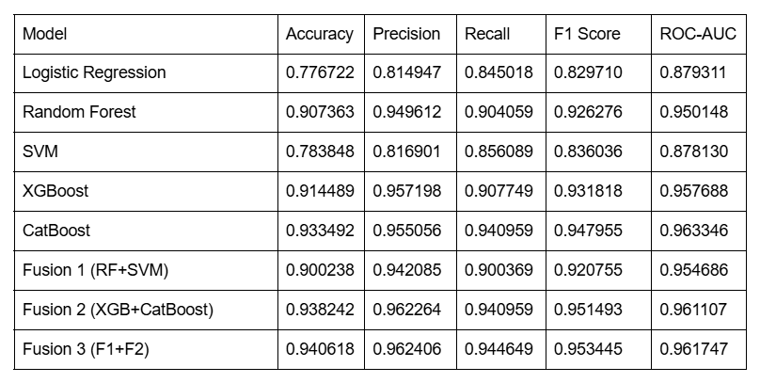
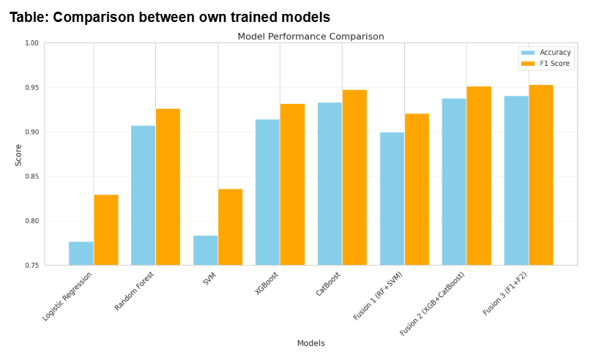
Methodology

Slide 9

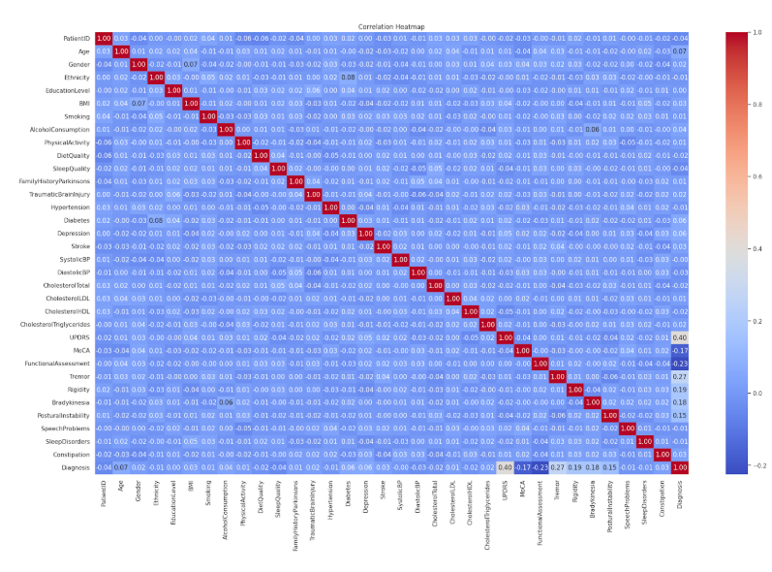
Hit Map

Slide 10
Conclusion
Our research focuses on leveraging machine learning models to enhance the diagnosis of Parkinson’s Disease. By evaluating individual algorithms and developing fusion models, we achieved improved accuracy and F1 scores, ensuring reliable and robust predictions. This feature-driven, interpretable approach bridges the gap between AI and clinical utility, contributing to early and accurate Parkinson’s diagnosis.

Slide 11


